Slide 1
Back Navigation Shortcuts for Screen Reader Users
Romisa Rohani Ghahari
Mexhid Ferati
Tao Yang
Davide Bolchini
October-22, 2012

Slide 2
Introduction
Introduction – Prototype – Hypotheses – Controlled Study – Results – Conclusion
In 2010, about 59,341 legally blind children – up to 21 years old – in the U.S. (American Printing House for the Blind)
Accessing the content is a necessary yet not sufficient condition for the usability of a website

Slide 3
Problem Statement
Introduction – Prototype – Hypotheses – Controlled Study – Results – Conclusion
Screen readers have a linear reading strategy
Boring and Frustrating
Frustration increases
Back Navigation with Screen Readers
Listen to and recognize a portion of each intermediate page
Aurally recover orientation of each page

Slide 4
Contribution of our Research
Introduction – Prototype – Hypotheses – Controlled Study – Results – Conclusion
Introduce two novel back navigation strategies
Topic-based back
List-based back
Webtime prototype
A controlled study with 10 blind high school students at the Indiana School for the Blind and Visually Impaired (ISBVI)

Slide 5
Introduction – Prototype – Hypotheses – Controlled Study – Results – Conclusion
Traditional back
# back steps = # visited pages
7
6
Teaching History
5
Research Interest
4
Education
Biography
9
3
8
Image
2
News Story
Curriculum
1
Admission
Description

Slide 6
Introduction – Prototype – Hypotheses – Controlled Study – Results – Conclusion
Traditional back # back steps = # visited pages
and listen to each one of them
7
6
Teaching History
5
Research Interest
4
Education
Biography
3
8
Image
2
News Story
Curriculum
1
Admission
Description

Slide 7
Introduction – Prototype – Hypotheses – Controlled Study – Results – Conclusion
Teaching History
Topic-based “Back” Navigation
Traditional back # back steps = # visited pages
Topic-based back # back steps = # visited topics
Research Interest
Education
Biography
Faculty
“John Smith”
Image
Curriculum
News Story
Admission
News Story
“J.S. Receives a new Grant”
Description
Program
“Ph.D. in Biology”
<last topic>
<last topic>
Topic-based “back”
navigation

Slide 8
Introduction – Prototype – Hypotheses – Controlled Study – Results – Conclusion
List-based “Back” Navigation
Traditional back
# back steps = # visited pages
Curriculum
Teaching History
Admission
Research Interest
Education
Teaching History
Description
Biography
Research Interest
Education
PhD Programs
All Programs
Biography
All Faculty
Adjunct Faculty

Slide 9
Introduction – Prototype – Hypotheses – Controlled Study – Results – Conclusion
List-based “Back” Navigation
Traditional back
# back steps = # visited pages
Curriculum
Teaching History
Admission
Research Interest
Education
Teaching History
Description
Biography
Research Interest
Education
PhD Programs
All Programs
Biography
All Faculty
Adjunct Faculty

Slide 10
Introduction – Prototype – Hypotheses – Controlled Study – Results – Conclusion
Curriculum
List-based “Back” Navigation
Traditional back
# back steps = # visited pages
List-based back
# back steps = # visited lists
Teaching History
Admission
Research Interest
Teaching History
Description
Education
Programs
“Ph.D. in Physics
Research Interest
Biography
Faculty
“Brian Miller”
Education
Ph.D. Programs
All Programs
Biography
Faculty
“Michael Bailey”
All Faculty
Adjunct Faculty
< back to list>
< back to list >

Slide 11
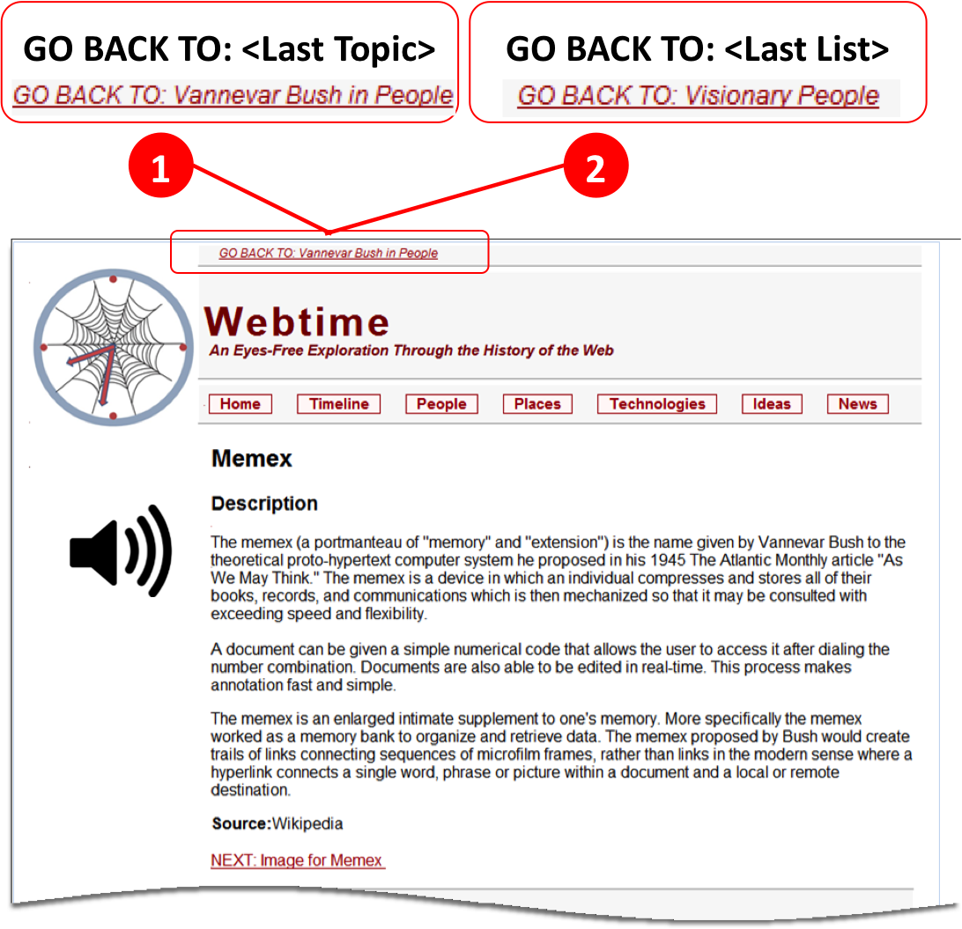
Webtime Prototype
Introduction – Prototype – Hypotheses – Controlled Study – Results – Conclusion
Accessibility tested with the W3C validator.
Screen readers Window-Eyes V 7.5
Internet Explorer V 8.0
Traditional back: http://discern.uits.iu.edu:8670/NSF_WEB/
Topic-based back: http://discern.uits.iu.edu:8670/NSF_WEB_TB/
List-based back: http://discern.uits.iu.edu:8670/NSF_WEB_UL/

Slide 12
Hypotheses
Introduction – Prototype – Hypotheses – Controlled Study – Results – Conclusion
H1: With respect to traditional back, topic-based back,
enables faster navigation to previously visited topics (H1.1)
yields a better navigation experience (H1.2)
reduces perceived cognitive effort for screen reader users (H1.3)
H2: With respect to traditional back, list-based back,
enables faster navigation to previously visited list pages (H2.1)
yields a better navigation experience (H2.2)
reduces perceived cognitive effort for screen reader users (H2.3)

Slide 13
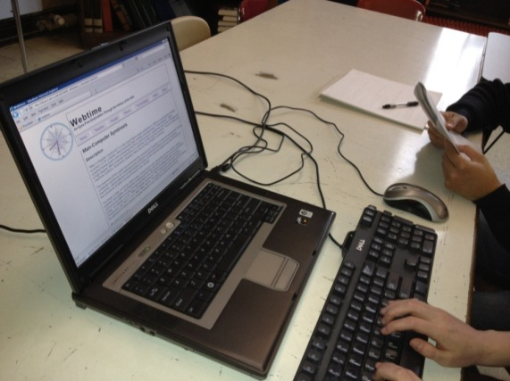
Physical Setup
Introduction – Prototype – Hypotheses – Controlled Study – Results – Conclusion
Controlled lab environment at Indiana School for the Blind and Visually Impaired (ISBVI)
School’s laptops
Screen readers Window-Eyes V 7.5 to auralize the content
Participants’ interactions were recorded using Morae Recorder V 3.2.
Webtime is optimized for Internet Explorer V 8.0

Slide 14
Controlled Design Evaluation (N = 10)
Introduction – Prototype – Hypotheses – Controlled Study – Results – Conclusion
Aural Navigation Strategy Tasks
45 min
5
participants
T
TB
Training on Topic-based
2 tasks
2 tasks
5
participants
TB
T
10
participants
2 tasks
2 tasks
Post-test Interview
Navigation and Cognitive Effort Questionnaire
Navigation and Cognitive Effort Questionnaire
45 min
5
participants
T
LB
Training on List-based
2 tasks
2 tasks
5
participants
LB
T
2 tasks
2 tasks
KEY:
T: Traditional back TB: Topic-based LB: List-based

Slide 15
Topic-based Task Example
Introduction – Prototype – Hypotheses – Controlled Study – Results – Conclusion
[Access a topic instance and browse its details] Go to the technologies section. Learn more about technology “Email.”
[Navigate to a related topic] Learn more about person “Ray Tomlinson” who has developed the technology “Email.”
[Access a topic instance and browse its details] Go to the “timeline” and see what happened in 1960, 1962, and 1965.
[Back to visited topic] Go back to person “Ray Tomlinson,” without using the backspace key, but using the “go back to” link. Make sure you recognize each page as you navigate back.

Slide 16
Introduction – Prototype – Hypotheses – Controlled Study – Results – Conclusion
Topic-based Back
Time-on-Task & Number of Backtracked Pages

Slide 17
Topic-based Back Keystrokes for Backtracking
Introduction – Prototype – Hypotheses – Controlled Study – Results – Conclusion

Slide 18
Topic-based Back Navigation Experience & Cognitive Effort
Introduction – Prototype – Hypotheses – Controlled Study – Results – Conclusion
1: Worst, 5: Best
1: Low, 5: High

Slide 19
List-based Back Time-on-Task & Number of Backtracked Pages
Introduction – Prototype – Hypotheses – Controlled Study – Results – Conclusion

Slide 20
List-based Back Keystrokes for Backtracking
Introduction – Prototype – Hypotheses – Controlled Study – Results – Conclusion

Slide 21
List-based Back Navigation Experience & Cognitive Effort
Introduction – Prototype – Hypotheses – Controlled Study – Results – Conclusion
1: Worst, 5: Best
1: Low, 5: High

Slide 22
Designer Model vs. Users’ Mental Model
Introduction – Prototype – Hypotheses – Controlled Study – Results – Conclusion
Back to Last Topic
Topic Page
GO BACK TO: “X”
Forward Navigation
Forward Navigation
List Page
Back to Last List
Designer Model
User’s Mental Model

Slide 23
Hypotheses Revisited
Introduction – Prototype – Hypotheses – Controlled Study – Results – Conclusion
H1: With respect to traditional back, topic-based back,
enables faster navigation to previously visited topics (H1.1)
yields a better navigation experience (H1.2)
reduces perceived cognitive effort for screen reader users (H1.3)
H2: With respect to traditional back, list-based back,
enables faster navigation to previously visited list pages (H2.1)
yields a better navigation experience (H2.2)
reduces perceived cognitive effort for screen reader users (H2.3)

Slide 24
Limitation
Introduction – Prototype – Hypotheses – Controlled Study – Results – Conclusion
Gender effect on the result
Designer has to identify topic and list from the web pages
Possible Solution
Provide an engine to automatically crawl a website and identify topics and list-pages

Slide 25
Conclusions and Future Work
Introduction – Prototype – Hypotheses – Controlled Study – Results – Conclusion
Topic-based and list-based back result in significant enhancements in both navigation efficiency and effectiveness
Exploring different input modalities (speech commands) to interact more naturally with aural information architectures
Investigate high-level vocabularies to enable screen reader users to interact with vocal commands on large websites

Slide 26
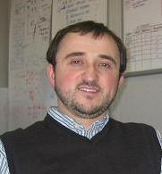
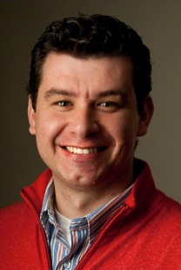
Thank you!
Mexhid Ferati, PhD
Tao Yang
Davide Bolchini, PhD
This research material is based on work supported by the National Science Foundation under Grant #1018054 “Navigating the Aural Web”.
Principal Investigator: Dr. Davide Bolchini
We thank all ISBVI participants, Al Lovati and Jim Durst for their continued support. We also thank J. George-Palilonis, L. He, D. Chattopadhyay, and Y. Jia for their comments to improve the manuscript.
http://mypage.iu.edu/~dbolchin/

